Slide 1


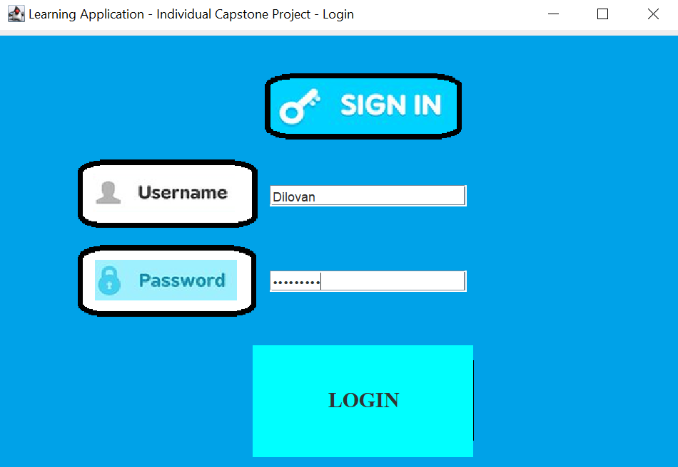
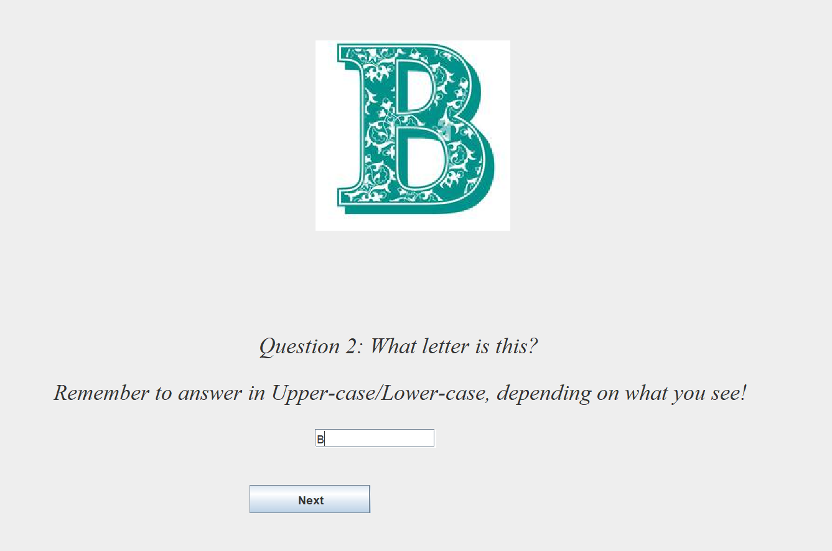
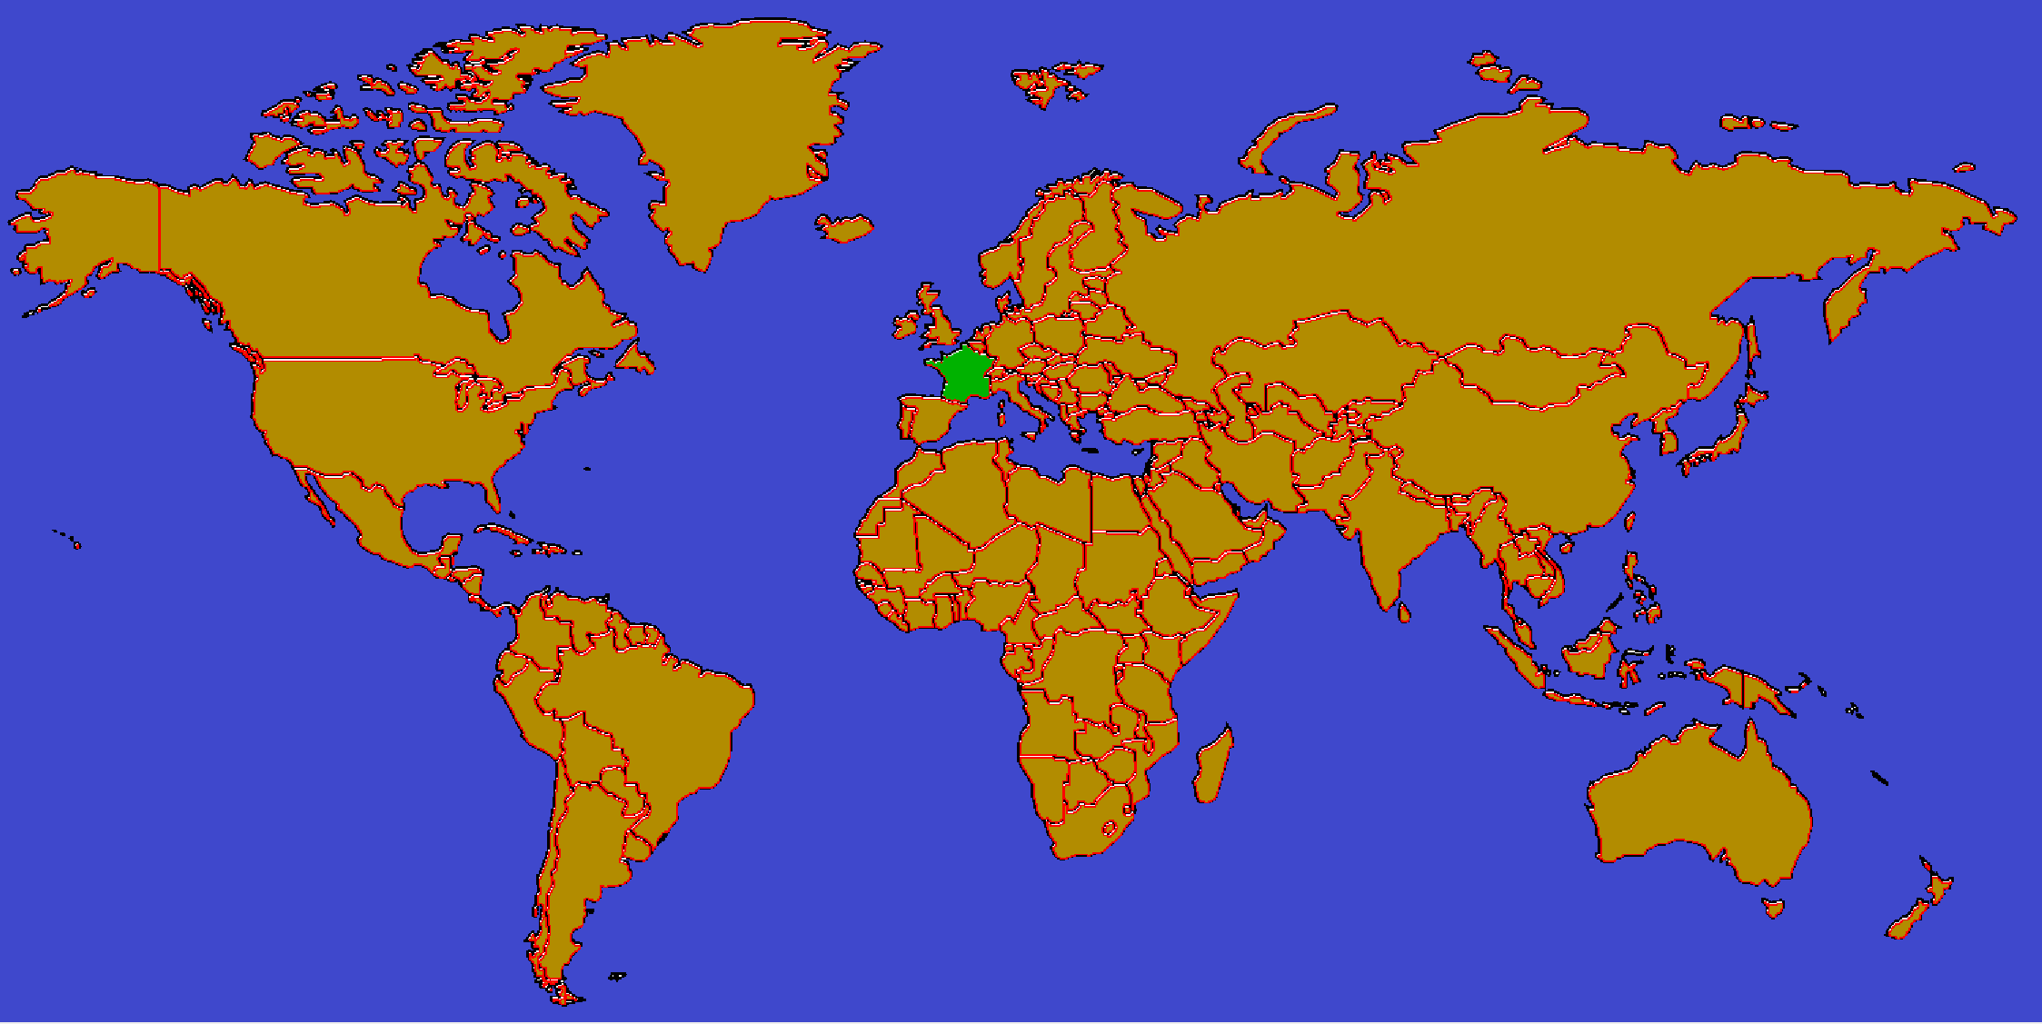
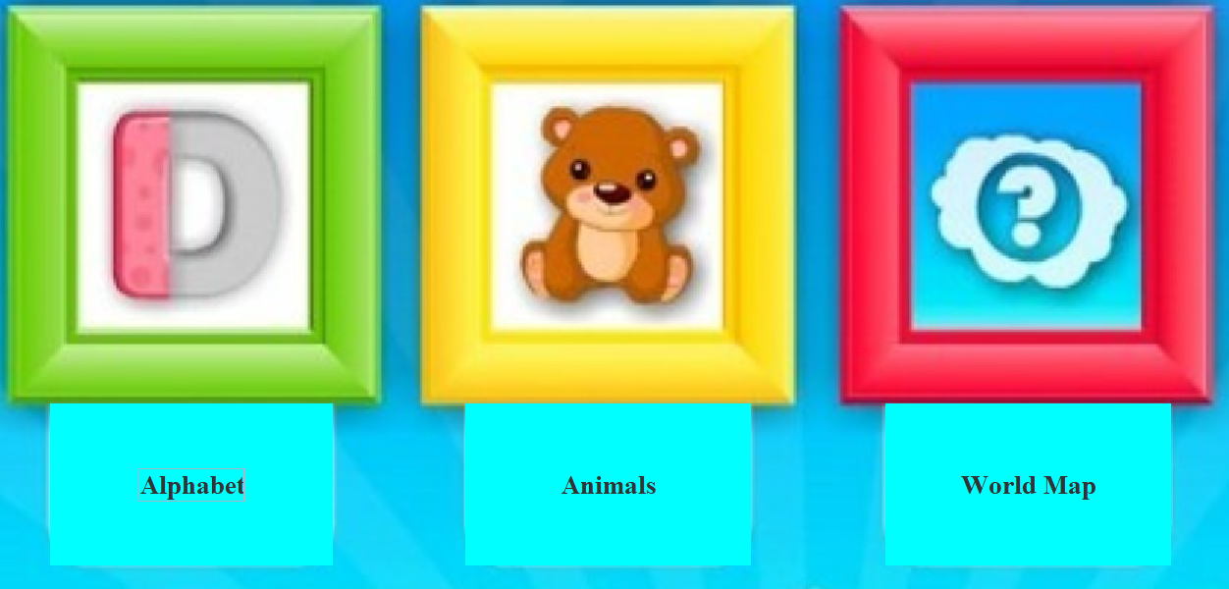

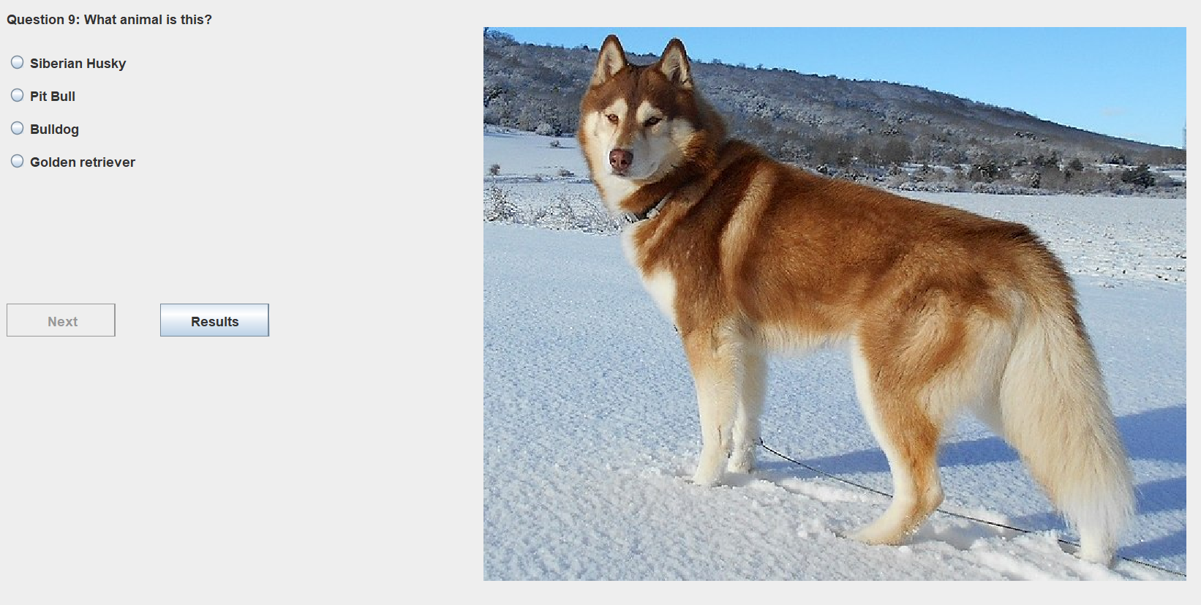

Educational Game for Children
Project Creator: Dilovan Panawandi | Project Supervisor: Dr. Bourazeri, Katerina
Project Introduction
Application that involves three educational minigames for children that struggle with school.
Language/Alphabet game
Geographic game
Animals/Insects game
Project Goals
To develop an application that makes education more fun and easier.
Application being widely used and seen as a very flexible application that you can play from anyplace at anytime.
Application bringing the children closer to each other by having friendly competition.
Additional Goals
To allow users, parents and teachers to interact with the application with ease, application being simple, direct and straightforward.
Login Page
A login page where every user will receive their own unique id and password. First year children should receive help.
Home Page
User will have the option on choosing which mini-game to play. (Design/interface not final)
Language/Alphabet
Game consist of only uppercase or lowercase letters and a combination of both. To answer the question you need to type in the input bar.
Animals
Nine questions with radio buttons.
Higher levels includes bugs and insects.
World Map
This is the highest level of difficulty where almost all countries are included.
User interacts directly with the map by clicking on the correct country with a 10 second timer.
Project tools
Java IntelliJ
MySQL for the database

